Slide 1
Benazir Bhutto’s Regime

Slide 2
Background:
Death of Shahnawaz Bhutto in 1985.
Benazir came Pakistan for his funeral.
Thousands of people joined her at the funeral.
She was then arrested.
A threat for Zia-ul-Haq.
Zia dissolved Junejo Government in 1988. And announced that fresh elections will be held.
But he died in a plane crash.
Presidential powers were then transferred to Chairman of the Senate G. I. Khan.

Slide 3
Benazir Government 1988-1990

Slide 4
Benazir Government 1988-1990:
Elections were held in 1988.
P. P. P won 94 seats but with co-operations and alliances they formed a government.
President G. I. Khan appointed her as the Prime Minister on the basis of R. C. O. (The revival of Constitution order).
She was sworn in as Prime minister and became the first woman to govern a Islamic state.
Then according to the deal with G. I. khan People’s Party voted for G. I. khan in presidential elections.

Slide 5
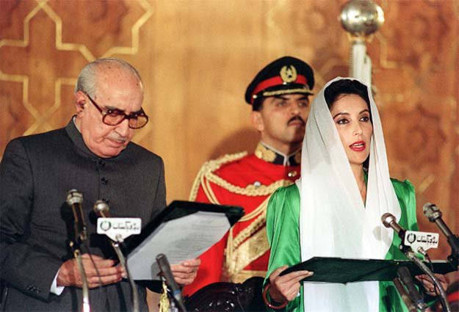

Slide 6
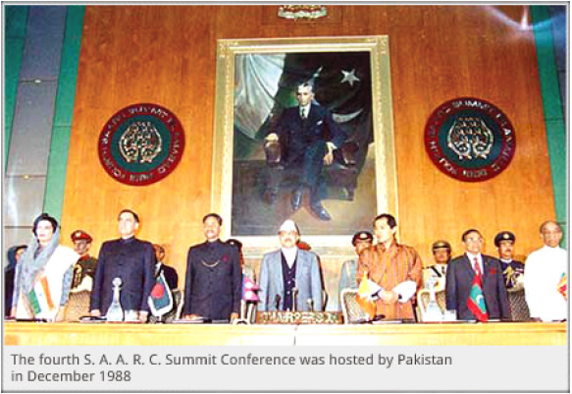
Major developments 1988-1990
Ban from Student and trade unions was lifted.
Benazir’s government hosted 4th SAARC summit conference in 1988.
Pakistan and India finalized three peace agreements as a result of this conference

Slide 7
Downfall 1988-1990
Influence of Military in politics.
Desertion from A. N. P and M. Q. M.
Her government was accused of corruption.
President then dismissed her government by exercising his powers according to the 8th Amendment.

Slide 8
Nawaz Era 1990-1993
p. p. p lost the 1990 elections and Nawaz shareef became the prime minister. But after 3 years both Nawaz and g. I . khan resigned due to some serious conflicts.

Slide 9
Return of Benazir 1993-1996

Slide 10
Introduction
Elections were held after the resignation of Nawaz And G. I. khan.
P. P. P won the elections and by making some alliances they formed a Government.
Benazir returns to power on October 19,1993.
P. P. P nominated Sardar Farooq leghari in presidential elections. In which he won.
Farooq was sworn in as President on November 13, 1993.

Slide 11
Major developments 1993-1996
Visit of First lady of U.S Hillary Clinton in 1995.
This visit changed world’s perspective about Pakistan.
Benazir visited U.S in 1994.
Brown Amendment was passed in U.S senate because of Benazir’s visit.
It helped attract more foreign investors.

Slide 12
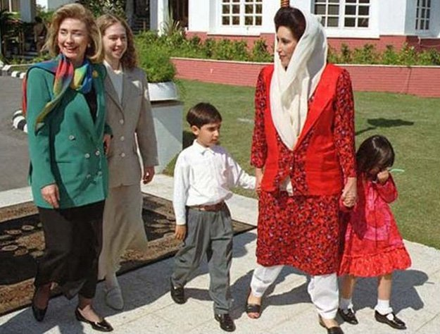

Slide 13
Downfall 1993-1996
As things were going good on foreign side but the government was facing serious problems in country.
Problems caused by M.Q.M and other parties.
Mir Murtaza Bhutto was killed in a mysterious police ambush in 1996.
Differences between the Government and President arose.
Leghari dismissed Benazir on charges of corruption and mismanagement.

Slide 14
